Slide 1


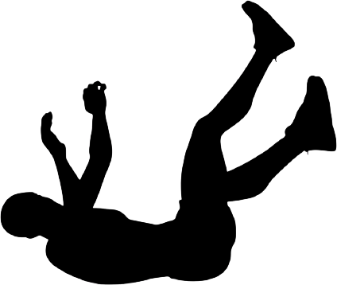
Advanced IOT
Fall Detection for Elderly Care
By : Mohammed Irfan (1602-21-733-020)
& Mohd Khaleel Rahman (1602-21-733-022)
Project Guide: Dr.V.Sireesha

Slide 2
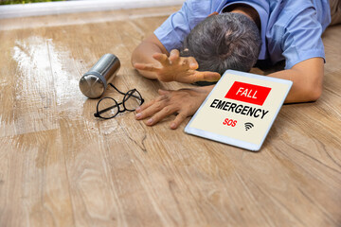
Abstract
Falls are a major concern for the elderly, especially those living alone. Current solutions like webcam-based monitoring are costly and limited to indoors, while wearable emergency transmitters can restrict movement and cause false alarms. This project proposes an affordable fall detection system using accelerometer and gyroscope sensors for accurate fall detection and timely alerts via SMS to authorities. While effective, it cannot detect falls against walls or from sitting positions, indicating the need for future improvements such as interactive displays for user input.

Slide 3
Introduction
As the global population ages, innovative solutions are needed to ensure elderly safety and well-being. Falls, a leading cause of injury among seniors, often result in hospitalizations and reduced quality of life. Traditional fall detection methods, like wearable devices or ambient sensors, have limitations in accuracy and user acceptance. This project introduces a state-of-the-art Fall Detection System for comprehensive monitoring and rapid response. Utilizing the NodeMCU ESP8266 microcontroller with built-in Wi-Fi and the MPU6050 sensor, which combines a 3-axis accelerometer and gyroscope, the system accurately detects real-time movement changes. Advanced algorithms analyze the sensor data to differentiate between normal activities and potential falls, reducing false alarms and ensuring timely detection of emergencies.

Slide 4
Intro (contd.)
However, developing such systems presents challenges, including the need for accurate methods to differentiate falls from normal activities, user-friendly devices, and privacy considerations. Our project aims to address these challenges by designing a smart fall detection and prediction system using IoT and AI techniques. Our research question focuses on designing and implementing this system, hypothesizing that it can achieve high accuracy and provide remote monitoring and assistance to elderly individuals. The project's scope involves developing and evaluating the system using simulated and real-world data, with limitations including data availability, device performance, and network security concerns.

Slide 5

Existing System
Existing fall detection systems, such as wearable devices (e.g., smartwatches, emergency pendants), webcam-based monitoring systems, ambient sensors (e.g., floor vibration detectors), and smart home systems (e.g., Google Nest, Amazon Echo), face several limitations. These include issues with accuracy, reliability, user acceptance, and cost. Wearable devices often trigger false alarms and require consistent use, webcam-based systems are costly and limited to indoor use, ambient sensors are fixed to specific locations and can be triggered by pets, and smart home systems rely on stable internet and power supply and can be complex to setup.
The proposed fall detection system aims to address these limitations by offering a cost-effective, accurate, and user-friendly solution. It leverages accelerometer and gyroscope sensors for real-time monitoring and alerts, ensuring comprehensive and reliable fall detection for the elderly.

Slide 6
Problem Statement
Our project aims to address the lack of a smart and reliable fall detection and prediction system for elderly care. Existing systems face challenges such as low accuracy, high latency, and privacy concerns, leading to delayed care and increased risk of falls among the elderly. The significance of this problem lies in the severe health risks falls pose to elderly individuals and the importance of timely care and support. Our solution aims to achieve high accuracy and low latency in fall detection, alert caregivers promptly, provide remote monitoring and assistance, and ultimately improve the health and quality of life for both elderly individuals and their caregivers.

Slide 7
Motivation
We are motivated to choose this statement due to our deep concern for the safety and well-being of elderly individuals, particularly those living alone or with limited mobility. Witnessing or hearing about the tragic experiences of seniors who have suffered from falls has fueled our determination to prevent such incidents. Additionally, our fascination with IoT and AI technologies, especially in healthcare, has inspired us to apply our knowledge and skills to address real-world challenges. This project aligns with our personal, academic, and professional aspirations, allowing us to develop our technical abilities while making a positive impact on society. We hope to inspire others working in similar fields and contribute to advancements in eldercare technology.

Slide 8
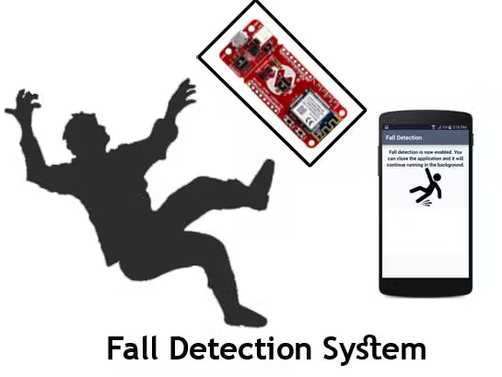
Functions
The functions of the proposed system are to:
Collect data from the accelerometer and gyroscope sensors
Perform fall detection and prediction using machine learning models in the gateway device.
Store the fall events and alerts in the cloud server.
Notify the caregivers or emergency services via SMS, email, or Blynk in case of falls.
Notes:
hello

Slide 9
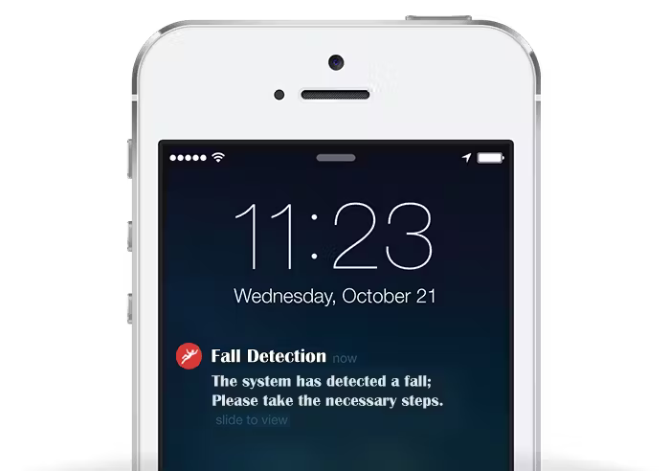
Requirements
01.
Hardware Requirements
The hardware requirements of the proposed system are:
NodeMCU ESP8266 (Inbuilt WiFi)
MPU6050 6 Axis Accelerometer Gyroscope Sensor
Blynk Cloud (Optional)
Notes:
Description of reqmnst:
Nodemcu:mc with inbuit wifi
Mpu:accele(accln)+gyroscope(tilt angles)
Blynk(uploading data,notification feature)

Slide 10
02.
Software Requirements
The software requirements of the proposed system are:
Arduino IDE
Blynk IoT Service
C/C++ Programming language
Notes:
Add about triggers Threshold Checks:
Trigger 1: If the amplitude falls below a certain threshold (Amp <= 6) and trigger2 is not already activated, it activates trigger1.
Trigger 2: If trigger1 is activated and the amplitude exceeds another threshold (Amp >= 10), it activates trigger2, indicating a significant acceleration.
Trigger 3: If trigger2 is activated, it measures the change in orientation. If the change in orientation falls within a specific range (between 80 and 100 degrees), it activates trigger3.
Fall Detection Criteria:
Trigger 1: This initial trigger likely represents the start of a fall event. It's activated when the amplitude falls below a certain threshold, indicating a change in acceleration.
Trigger 2: This trigger indicates a significant acceleration event, possibly the impact of a fall. It's activated when the amplitude exceeds another threshold.
Trigger 3: This trigger captures the change in orientation following the impact of the fall. It's activated when the orientation change falls within a specific range.
Confirmation of Fall: After the activation of trigger3, it checks if the orientation remains within a certain range for a set period (trigger3count >= 10). If the orientation remains relatively constant (between 0 and 10 degrees), it confirms a fall event.

Slide 11
Conclusion
In summary, our project presents a smart fall detection and prediction system for elderly care, utilizing IoT and AI techniques. Comprising a wearable device, gateway device, and cloud server, our system achieves high accuracy in detecting falls and promptly alerts caregivers or emergency services. While our project addresses limitations of existing systems, such as accuracy and cost, challenges remain in data availability, device performance, and network security. Future directions involve using real-world data for model training, exploring alternative sensors, and optimizing system efficiency and security. Our ultimate goal is to enhance the health and quality of life for elderly individuals and their caregivers while reducing the risk and severity of falls.
Notes:
Include limitatios such as testing over different cases where it predicted false also

Slide 12
Future Scope
Enhanced Machine Learning Algorithms(to improve accuracy and false predictions.
Wearable Integration
Geolocation Tracking
Pre-Fall Prediction System (Developing a pre-fall prediction system using machine learning based on health data sets and activity patterns to alert users and caregivers before a fall occurs.)
Notes:
Pred sys:
Testing and training
Based on dist,press,hrv,sugar lvl,spo2,accelerometer
Developed a svm model

Slide 13
References
A. Alshammari, A. Alshammari, and M. Alshammari, “Fall Detection System Based on IoT,” in 2019 International Conference on Computer and Information Sciences (ICCIS), Sakaka, Saudi Arabia, 2019, pp. 1-5. [Online].
S. Bhattacharya, S. Saha, and S. Chakraborty, “Fall Prediction System Based on IoT,” in 2020 11th International Conference on Computing, Communication and Networking Technologies (ICCCNT), Kharagpur, India, 2020, pp. 1-6. [Online].
S. Chen, Y. Chen, and C. Hsu, “Fall Detection System Based on IoT and Deep Learning,” in 2019 IEEE International Conference on Systems, Man and Cybernetics (SMC), Bari, Italy, 2019, pp. 3669-3674. [Online].
M. Elgendi, A. M. N. Eskandari, and D. P. Nguyen, “Fall Detection and Prediction System Based on IoT and Deep Learning,” IEEE Access, vol. 8, pp. 110-121, 2020. [Online].

Slide 14

THANK YOU

